Slide 1
Maths/Linear Algebra/ Tut1
Chng Eng Siong
25 Aug 2020

Slide 2
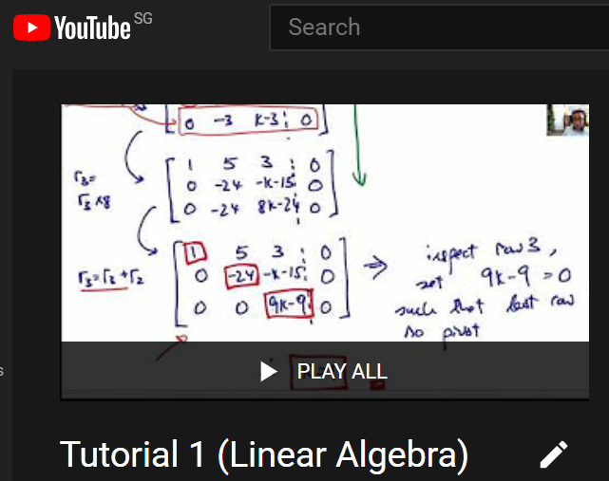
Tutorial 1 Help links
Youtube link:
https://www.youtube.com/playlist?list=PLki3aFwg-9eySloSK13yOXJZS2A4l3ieR
PDF
Q1-6: https://www.dropbox.com/s/5uu7y0jfmuy9ya9/Tut1_Q1_6_ces.pdf?dl=0
Q7-11: https://www.dropbox.com/s/5643rayuklilafg/Tut1_Q7_11_ces.pdf?dl=0
Example of 1Eqn2Unknown, 2Eqn2Unknown, 3Eqn,2Unknown: https://www.dropbox.com/s/npx804bqn8bdr9e/Tut1_Support_3CasesOfLinearEq.pdf?dl=0

Slide 3
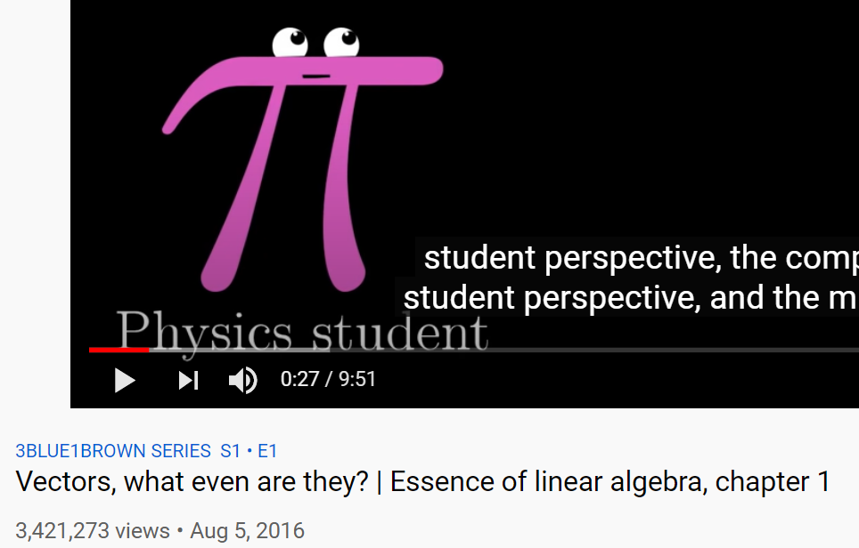
Good Reference
Introduction to vectors and Linear Algebra: 3Blue1Brown
https://www.youtube.com/watch?v=fNk_zzaMoSs

Slide 4
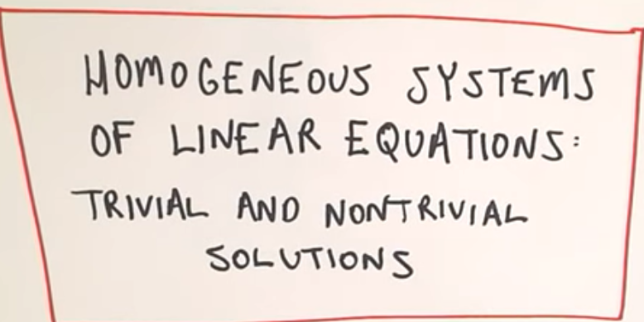
Q1
How t do Gaussian Elimination:
Ref: https://www.youtube.com/watch?v=JlJWyWJARRU
https://www.youtube.com/watch?v=lerx7O6HfFA

Slide 5
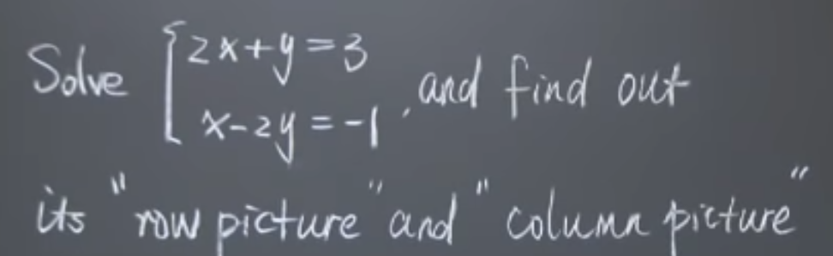
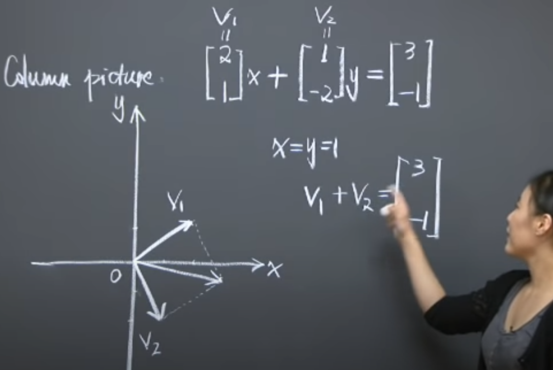
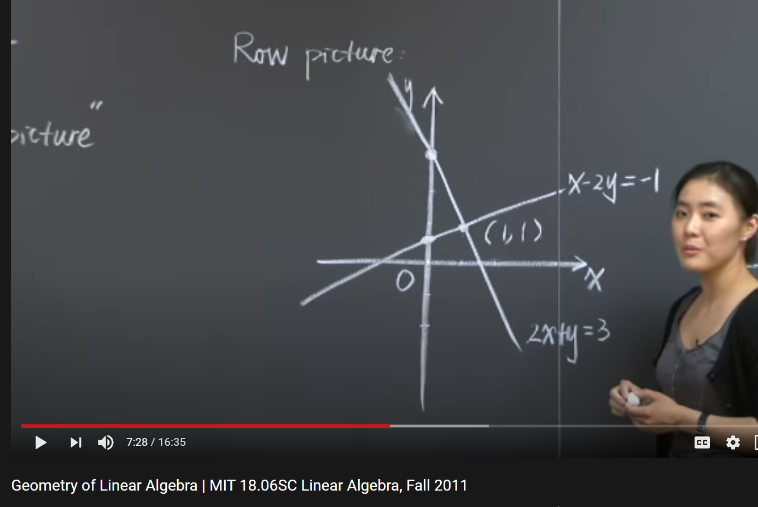
Q2) System of Linear eqns and its Solution: geometry
Ref:Geometry of Linear Algebra | MIT 18.06SC Linear Algebra, Fall 2011
https://www.youtube.com/watch?v=uNKDw46_Ev4

Slide 6
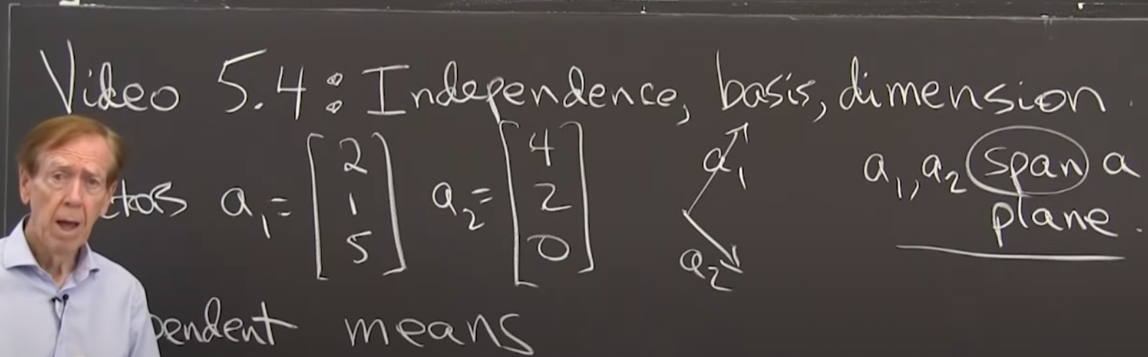
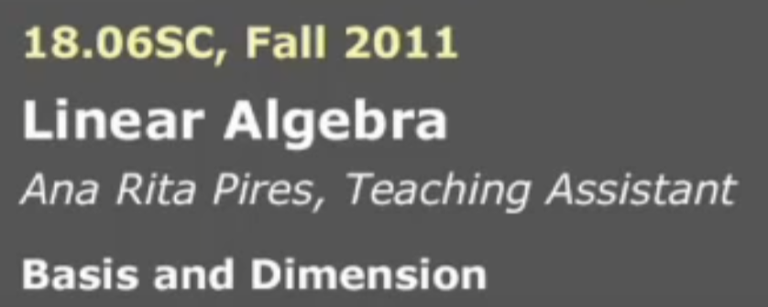
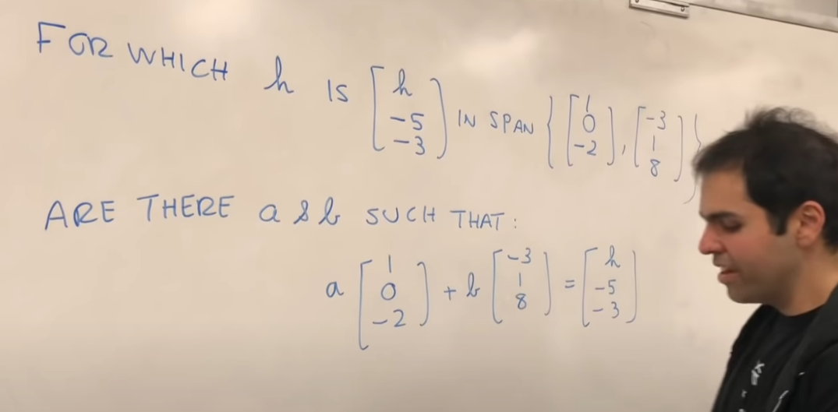
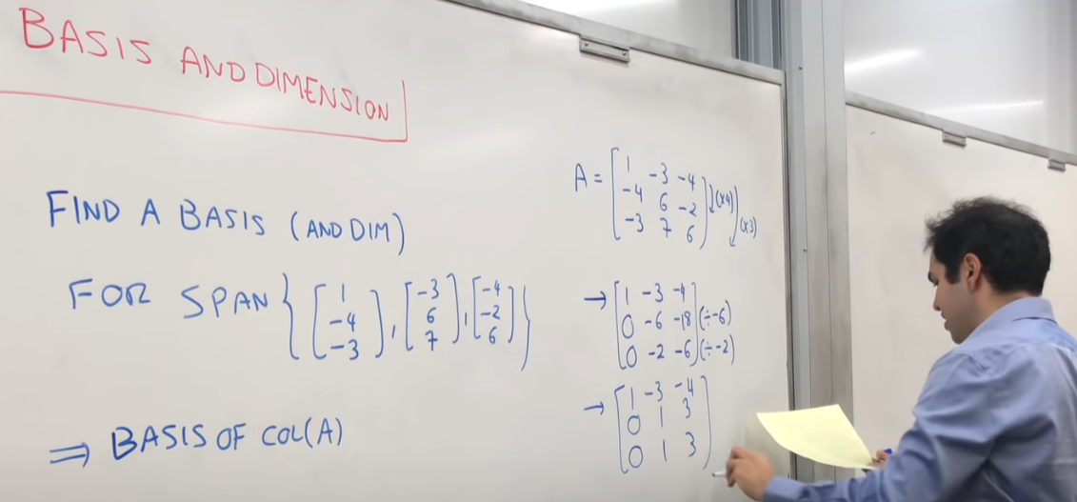
Q6) Span, Basis and Dimension
Ref:
1) Strang, MIT: https://www.youtube.com/watch?v=eeMJg4uI7o0
tutorial: https://www.youtube.com/watch?v=AqXOYgpbMBM
2) Peyam: Span: https://www.youtube.com/watch?v=vmXmvSsi4ks
Basis and Dimension https://www.youtube.com/watch?v=pjMwZPo8UvQ

Slide 7
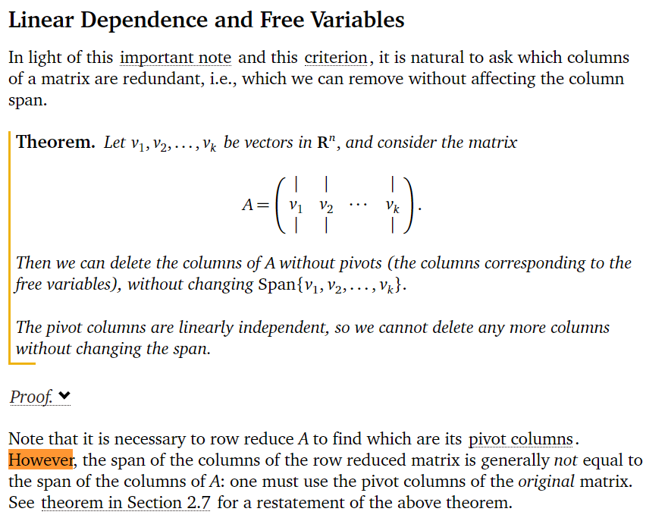
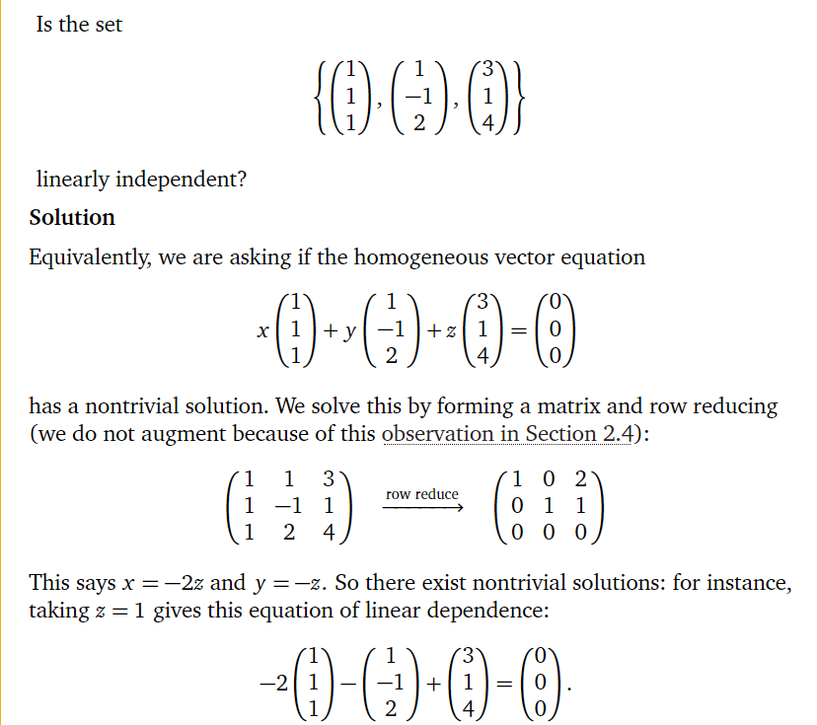
Q6) Span and Linear Independence
Question: How is pivot related to independent column of matrix?
Ref: https://textbooks.math.gatech.edu/ila/linear-independence.html

Slide 8
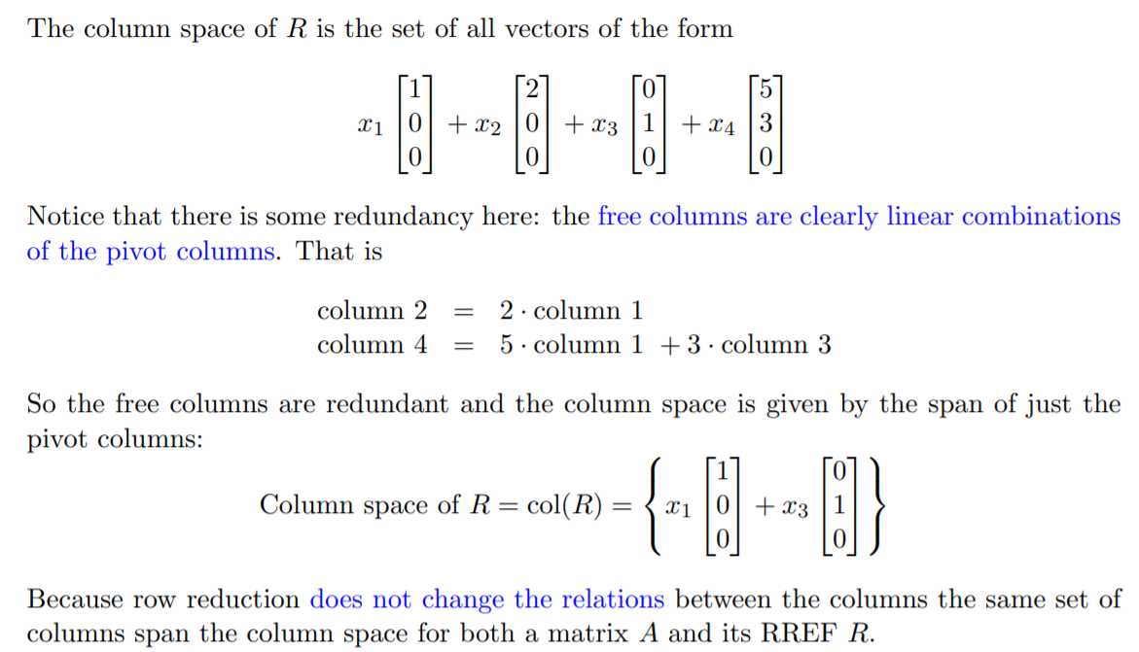
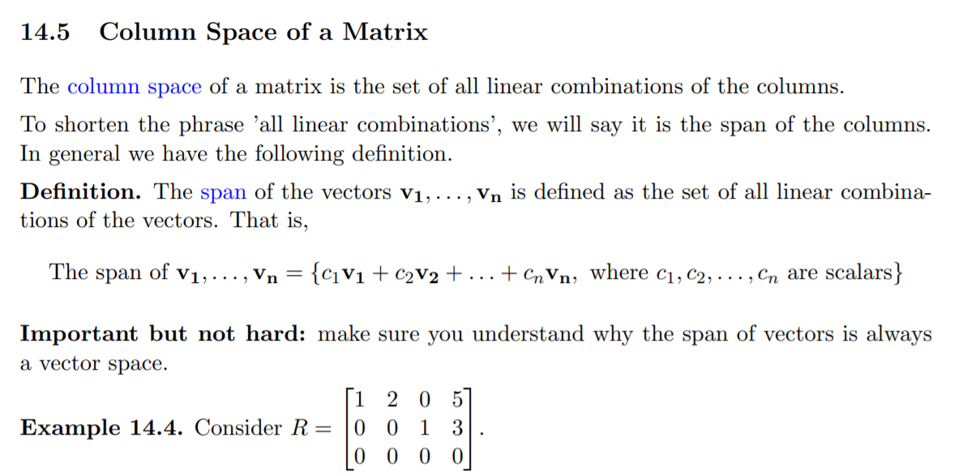
Q6) Why pivot reveals indepedence (col)
Ref:http://web.mit.edu/jorloff/www/18.03-esg/notes/topic14.pdf
Pg 4+5

Slide 9
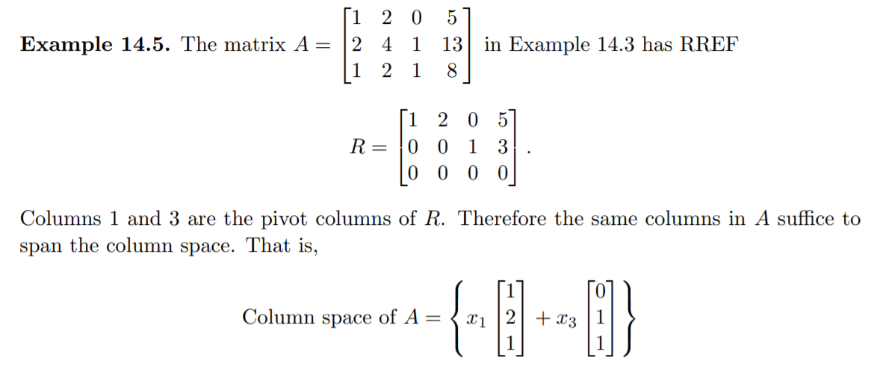
In general, row operations do change the column space.
https://math.stackexchange.com/questions/1376284/do-row-operations-change-the-column-space-of-a-matrix
But the relationship between the columns does not change.

Slide 10
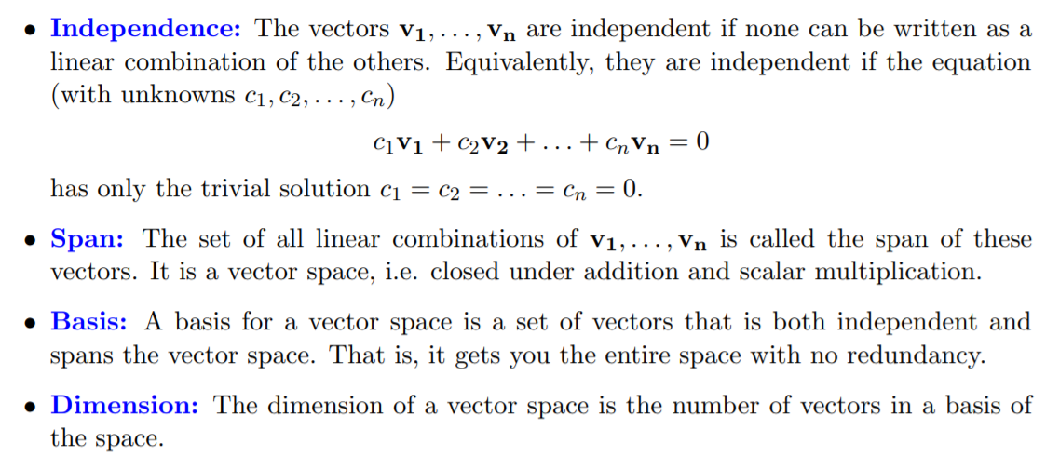

Slide 11
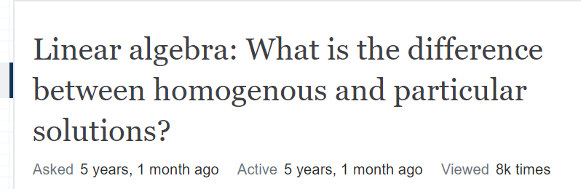
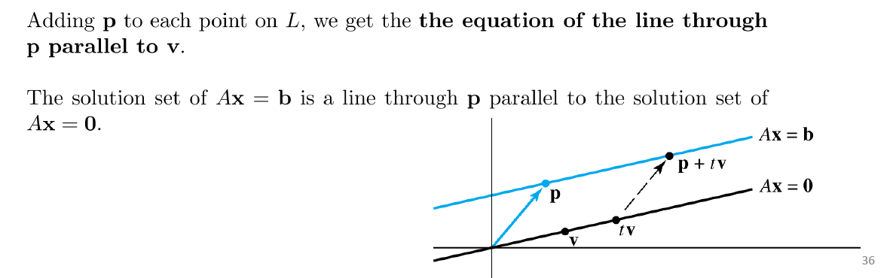
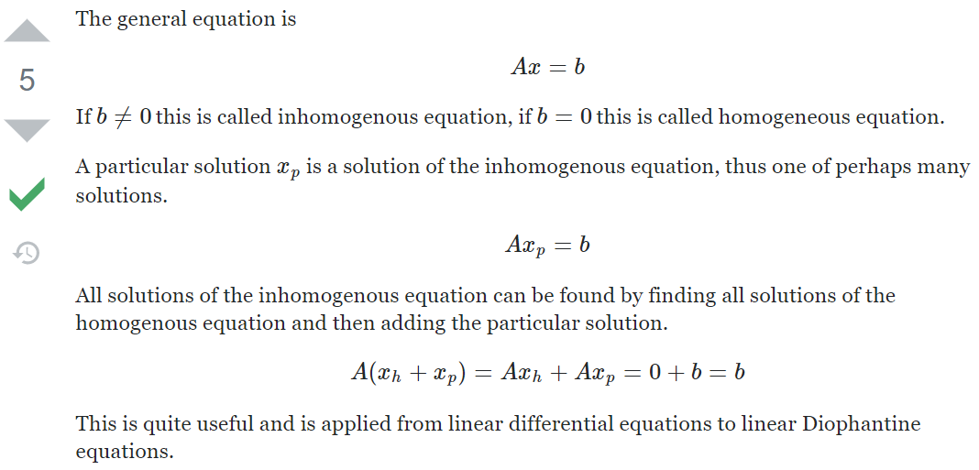
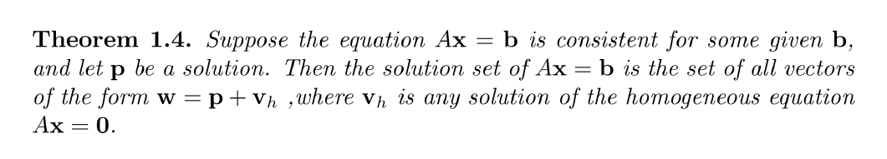
Tut1: Q7 explanation

Slide 12
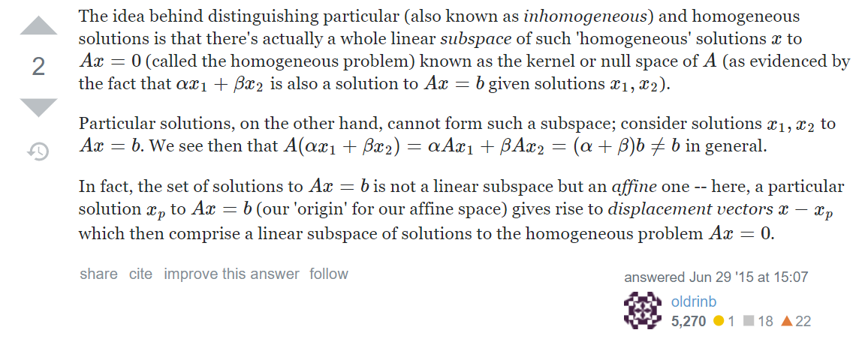
Tut1: Q7 explanation

Slide 13
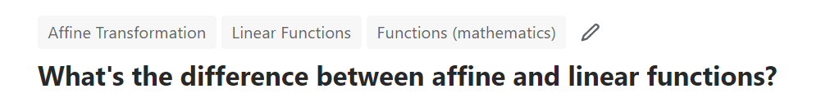
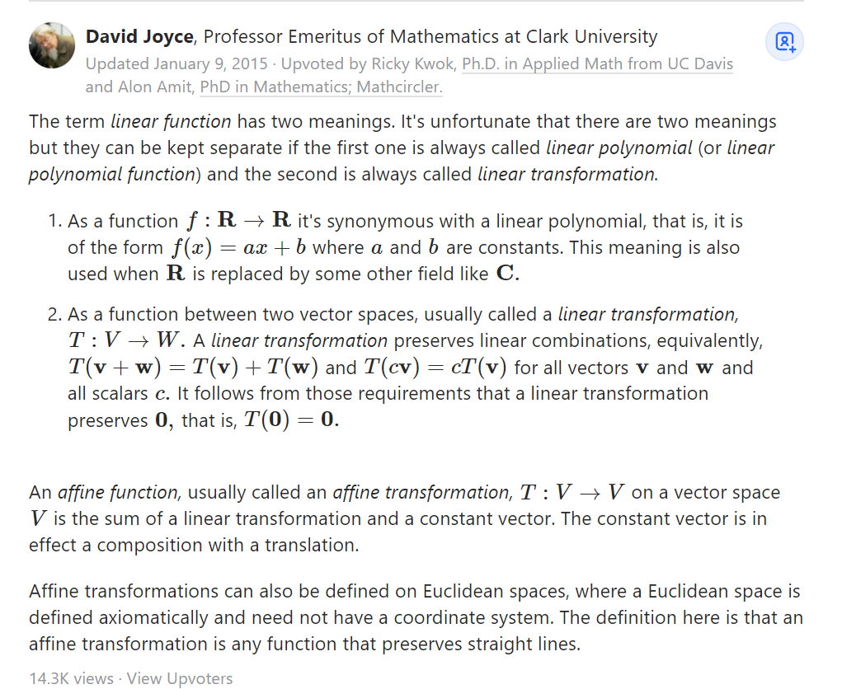
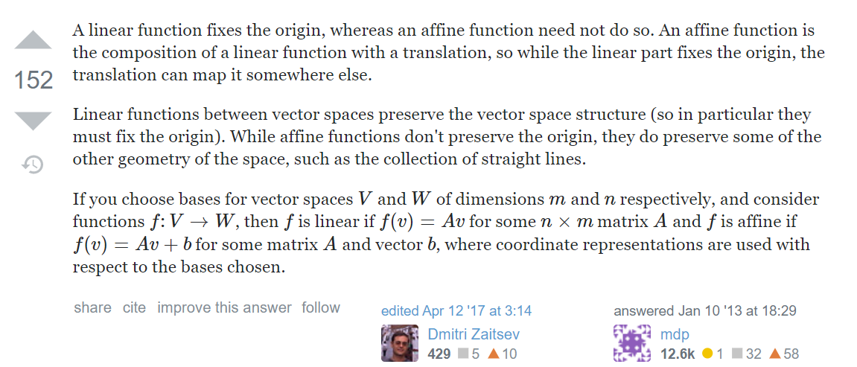
https://www.quora.com/Whats-the-difference-between-affine-and-linear-functions
https://math.stackexchange.com/questions/1343306/linear-algebra-what-is-the-difference-between-homogenous-and-particular-solutio

Slide 14
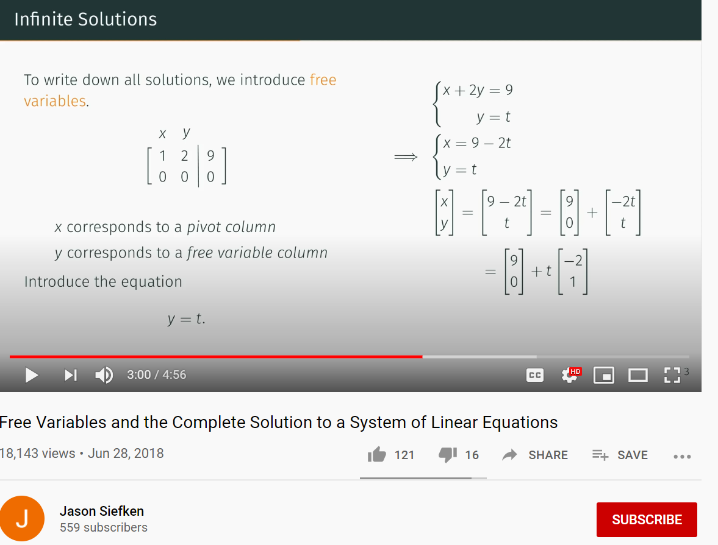
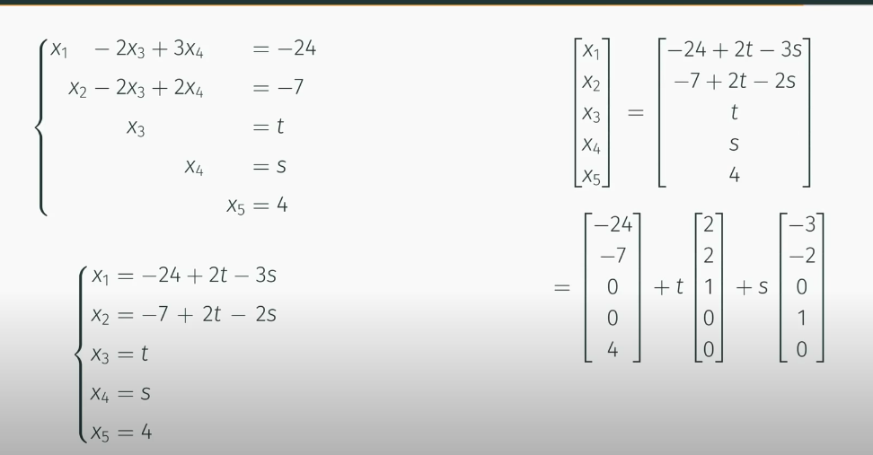
Q7) Complete solution with free variable
Ref: https://www.youtube.com/watch?v=nUt1BeoqE4g

